Slide 1
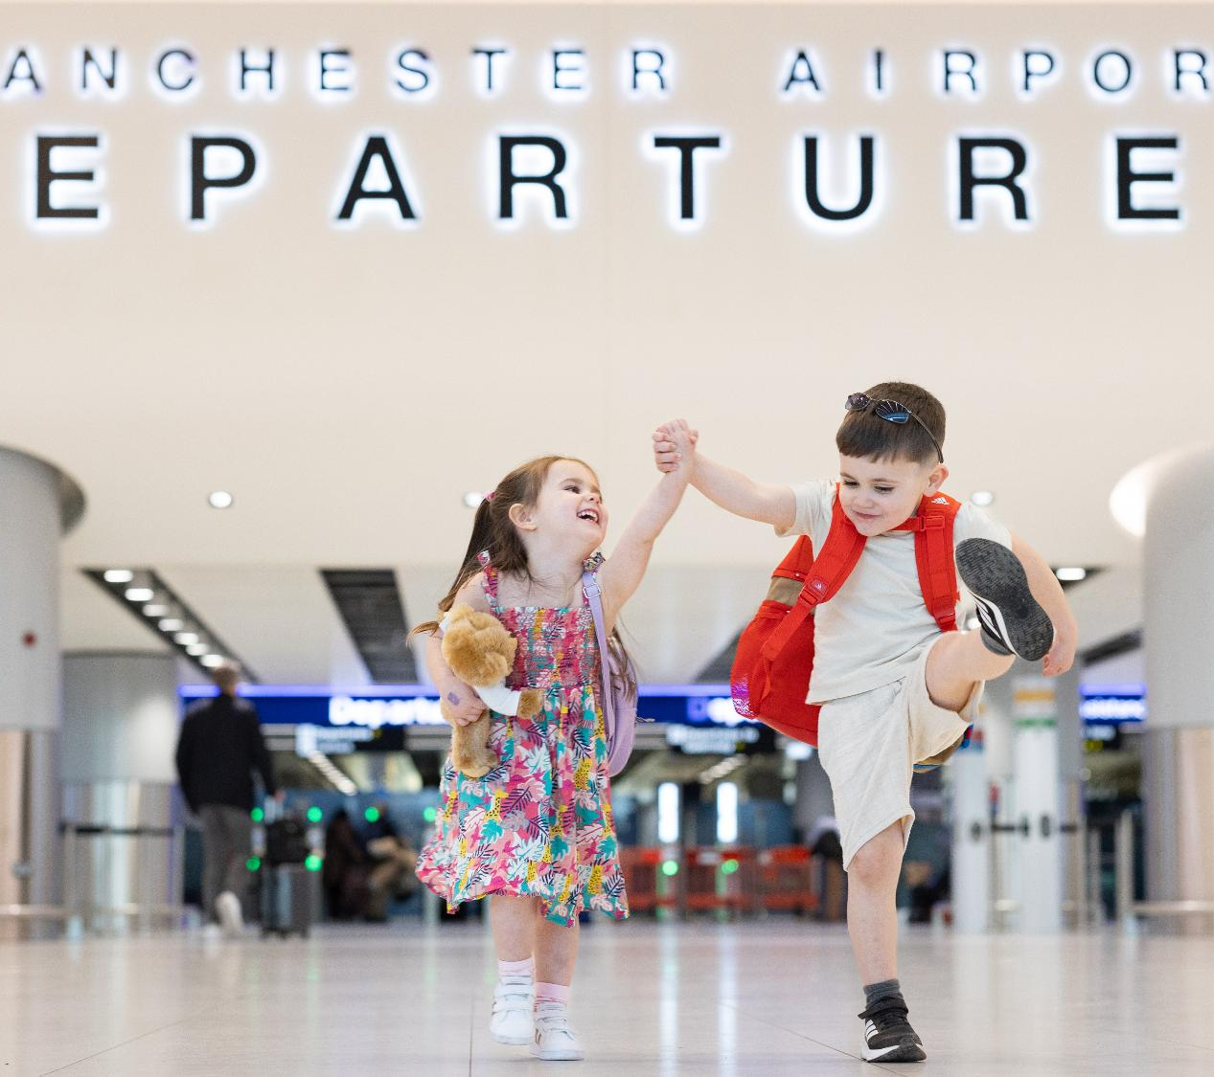
Manchester Airports Group
Investor Presentation
Results for the year ended 31 March 2026
July 2026

Slide 2
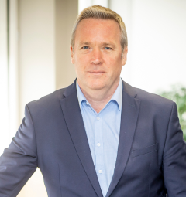

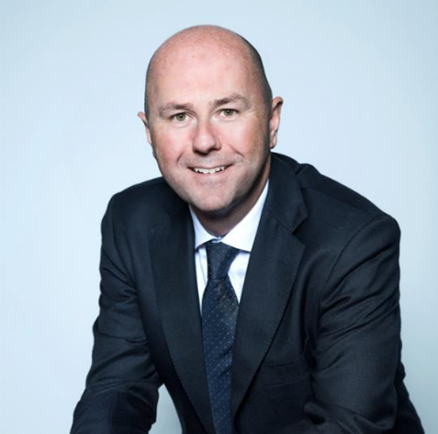
Introduction
Ken O’Toole
  Chief Executive Officer
Marie Joyce
  Chief Financial Officer
Iain Ashworth
  Corporate Finance Director

Slide 3
Who we are
The UK’s largest airports group and growing global travel services business
More than
85 years’ aviation experience
One in five UK air travellers use a
MAG airport
Public-private ownership model
66m
annual passengers
280+ global
destinations served
CAVU Operations in
58
countries
3,900+
CAVU products worldwide
MAN
USA
EMA
STN
ASIA
AUSTRALIA
3

Slide 4
Contents
FY26 Highlights | 5
Passenger & Trading Performance | 10
Capital Investment | 15
Financing | 17
Sustainability | 22
Appendices | 25

Slide 5
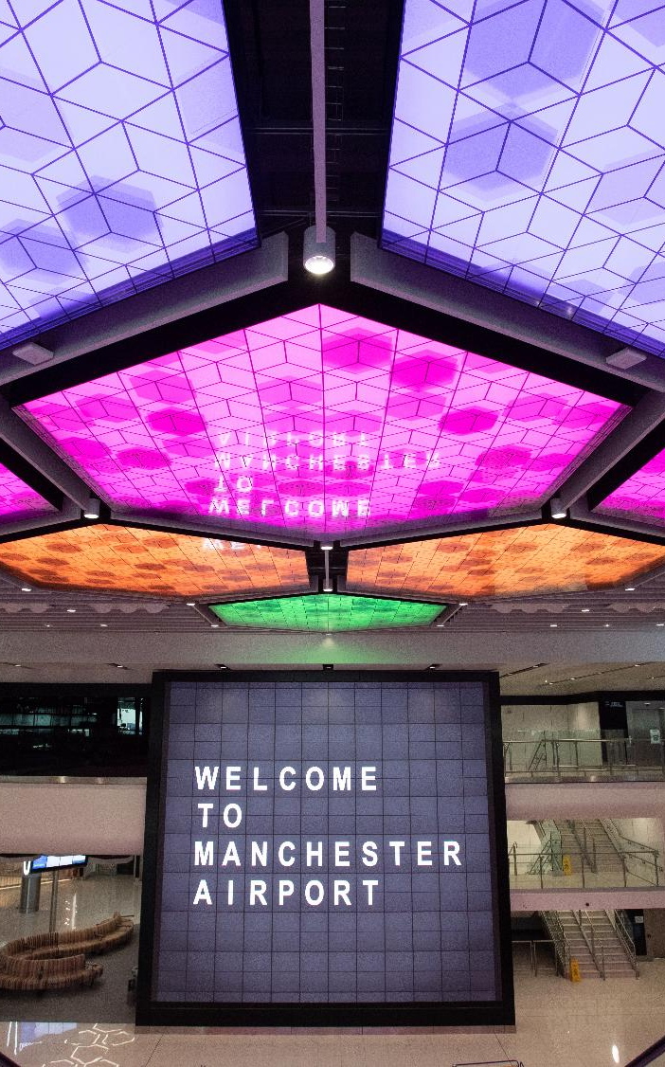
FY26 Highlights

Slide 6
At a Glance
  Despite significant geopolitical and macroeconomic uncertainty, MAG delivered record revenue and EBITDA for the fourth consecutive year.
  Growth in EBITDA delivered across our airport portfolio and CAVU:
  Record passenger numbers across the year
  Strong growth across aero and non-aero revenues, with yield improvement across all key revenue streams
  EBITDA increasing to record levels, despite impact of Middle East conflict in March 2026
  Continuing to make progress against our non-financial KPI targets
PAX
  66.3m
  +1.9 %
REVENUE
  £1,514.7m
  +12.8%
ADJUSTED EBITDA
  £614.4m
  +7.7%
AERO-REVENUE
  £516.1m
  +9.9%
ADJUSTED CASH FROM OPERATIONS
  £609.4m
  +6.8%
NON-AERO REVENUE
  £998.6m
  +14.4%
CARBON REDUCTION – CO₂ EMISSIONS
  0.188 tonnes CO₂e
  -2.1%
FEMALE LEADERSHIP
  38.7%
  +3.6pp

Slide 7
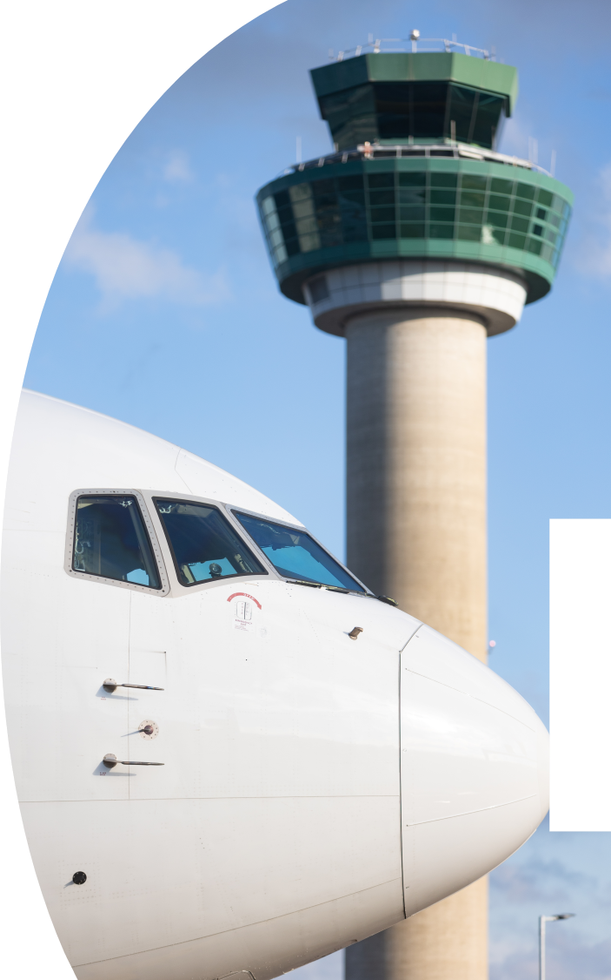
FY26 Highlights
  Passengers
  66.3m pax in FY26 - up 1.3m (1.9%) compared to the prior year
    Record pax at both Manchester and Stansted
    Stansted exceeded 30m annual pax for the first time
    Routes continued to strengthen as airlines introduced new destinations and capacity
  EBITDA
    EBITDA increased by £44.0m (7.7%) to reach a record £614.4m
    Driven by increased passenger volumes, coupled with yield improvements across all principal revenue streams
    All of MAG’s airports and divisions reported positive EBITDA despite headwinds of rising costs
    Escalation of the conflict in the Middle East impacted passenger numbers and EBITDA in March 2026 but year-on-year growth still continues into FY27
  Cashflow
    MAG’s adjusted cash from operations of £609.4m was a £38.7m (6.8%) increase over last year reflecting strong trading performance
    Net movement in cash during the year was an inflow of £3.8m
    Modest inflow reflects MAG’s continued investment in its infrastructure with cash capex of £586.2m in FY26 and bond raise of £300m in January 2026.

Slide 8
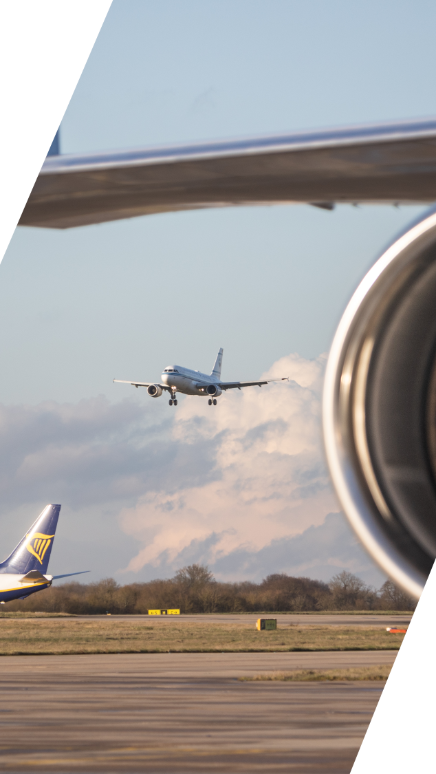
FY26 Highlights
  Financial Covenants
  3.9x Net Debt to EBITDA as at 31 March 2026. Interest Cover of 5.6x
    Significant financial headroom to invest in growth and improve passenger experience
    Plans to invest more than £2.5bn in our three airports over the next five years
  Financing
    MAG successfully returned to the Sterling debt capital markets in 2026 following debut Euro issuance in FY25
    £300m 10-year bond issued in January 2026
    Coupon of 5.25% (G+80bps), representing a record low margin for a UK airport issuer
    Issuance brought forward from H1 FY27 to take advantage of favourable market conditions and de-risk business plan debt requirements
  Business Outlook
    FY26 was characterised by significant fiscal and geopolitical headwinds. Conflict in the Middle East, and knock-on effects which will continue to shape our operating environment
    During the period these were largely navigated by MAG but likely to persist through FY27
    We remain disciplined in managing global uncertainties through active risk management, operational flexibility and prudent financial planning, ensuring continuity of service delivery

Slide 9
FY26 Divisional Highlights
MANCHESTER AIRPORT
Served 32.3m passengers
Revenue of £630m and EBITDA of £266m
211 destinations served
EAST MIDLANDS AIRPORT
UK’s largest pure freight operation – handled over 413,000 tonnes of cargo
4.0m passengers
Revenue of £112m and EBITDA of £51m
LONDON STANSTED AIRPORT
202 destinations worldwide, including more European connections than any other UK airport
Carried 30.0m passengers
Revenue of £480m and EBITDA of £195m
CAVU
Provides services to MAG and other airports internationally, spanning digital and e-commerce platforms and physical, in airport experiences
CAVU presence extends across 399 airports in 58 countries, including 32 lounges across the UK, US and Australia
Revenue of £289m, generating EBITDA of £77m
£14bn
Contribution to
UK economy
UK’s largest private
transport infrastructure
investor outside London
45,000+
Jobs supported
70%
of UK population within
two hours of a MAG airport
805,000
tonnes of cargo
handled per year
MAN
EMA
STN
9

Slide 10

Passenger & Trading Performance

Slide 11
Passenger Performance
MAG’s airports welcomed 66.3m passengers in the year to 31 March 2026, 1.3m (1.9%) more than the same period last year. Manchester (32.3m) and Stansted (30.0m) once again had record passenger numbers
    Passenger growth was delivered from a combination of new routes and capacity on existing services
    Manchester and Stansted carried record number of passengers at 32.3m and 30.0m, remaining the third and fourth busiest airports in the UK respectively. East Midlands once again carried 4.0m and continues to increase market share as the UK’s largest pure freight operation
    Strong passenger throughput efficiency, with 99% of passengers passing through security in 15 mins or less, across our airports throughout the year
    The majority of the passenger increase has come from Ryanair and easyJet growth
65.0m
66.3m

Slide 12
Growing and diversified route network
Asia
Manchester Airport offers direct
Far East connectivity, with direct
routes to Beijing, Shanghai, Hong
Kong, Singapore and Bangkok.
East Midlands and London Stansted Airports serve direct cargo routes to key Asian markets
Europe
Direct connections to 234 European destinations, with multiple daily frequencies to many of the most popular. London Stansted’s European network is unparalleled among UK airports. CAVU operates both in the UK and the Netherlands, following the acquisition of parking comparison site, Parkos
Growth was driven by both an increase in the number of routes served by our carriers, and in the frequency of services to the most popular destinations with UK travellers. Our airports now connect business and leisure travellers in the North, South and Midlands with more than 280 locations globally
    Flights to Dublin, Dubai, Spain (Canaries, Balearics and the mainland), Turkey and Amsterdam remain MAG’s most popular destinations.
    MAG continues to provide an expanding range of choice for all passengers, with net increases of 9 new destinations and 2 new airline operators.
The Americas
Manchester Airport has a large transatlantic network, with direct routes to many US cities as well as destinations in Canada, the Caribbean and Mexico. CAVU operates in major international airports and extends across 20 airport markets in the US
Middle East
Our airports serve multiple Middle East routes, with direct services to the key hubs of Dubai, Abu Dhabi and Qatar, alongside Saudi Arabia, Kuwait and Bahrain. London Stansted’s double daily service to Dubai continues to be popular with passengers
Australia
CAVU operates at 2 airports in
Australia, offering a range of car
parking products to passengers, as well as operating airport lounge in Brisbane
Africa
Popular North African destinations are served from Manchester, as well as a critical route into Addis Ababa, Ethiopia, which provides access to a key central African hub

Slide 13
FY26 EBITDA
EBITDA has increased from £570m in FY25 to a record £614m in the year to 31 March 2026. All of MAG’s airports and divisions reported EBITDA growth.
    EBITDA growth driven by both positive passenger and cargo growth across our airports, underpinned by our continued investment in infrastructure

Slide 14
FY26 Trading Performance
EBITDA for the Group increased by £44m (+8%) to reach a record £614m. Driven by a £172m (+13%) passenger and yield driven revenue uplift. The revenue uplift more than offset cost pressures, primarily from increasing employee costs, headcount and infrastructure costs, with overall total operating cost increases of £128m(+17%)
£m | FY26 | FY25 | Variance (£m) | Variance (%)
Aeronautical | 516.1 | 469.7 | +46.4 | +9.9%
Retail | 374.7 | 327.9 | +46.8 | +14.3%
Car Parking | 453.3 | 406.1 | +47.2 | +11.6%
Property | 23.1 | 19.4 | +3.7 | +19.1%
Other | 147.5 | 119.4 | +28.1 | +23.5%
Revenue | 1,514.7 | 1,342.5 | +172.2 | +12.8%
Employee costs | (429.0) | (385.3) | (43.7) | (11.3%)
Non-employee costs | (471.3) | (386.8) | (84.5) | (21.8%)
Operating Costs | (900.3) | (772.1) | (128.2) | (16.6%)
EBITDA | 614.4 | 570.4 | +44.0 | +7.7%
AVIATION
  £516m (+10%)
  Yields improved across all 3 airports
  Supported by pax growth at Manchester and Stansted
CAR PARKING
  £453m (+12%)
  Yields improved year-on-year
  Supported by pax volume and a full year of Parkos income (acquired FY25)
RETAIL
  £375m (+14%)
  Yields improved across all 3 airports
  Growth in CAVU from new lounges across key international markets (US, UK and Australia)
PROPERTY AND OTHER
  £171m (+23%)
  Property increased driven by improved rental income
  Other income includes utility recharges, income from car rental operations and airline staff parking agreements
OPERATING COSTS
  £900m (+17%)
  Rise in employee costs (primarily due to pay awards and headcount increase)
  Non-employee costs primarily reflects impact of Parkos, inflationary pressures and increased marketing costs (PPC) in CAVU

Slide 15
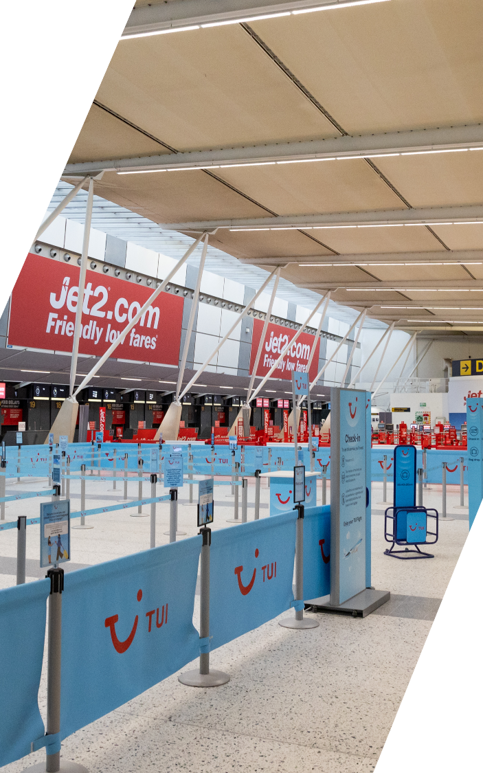
Capital Investment

Slide 16
FY26 Capital Investment
We are continuing to invest heavily to support growth and improve passenger experience, with plans to invest £2.5bn to unlock the potential of our airports’ runways over the next five years.
  Completed the final phase of the Manchester Airport Transformation Programme (MAN-TP), which will enhance the passenger experience and support growth over the coming decades.
  Commenced work on the Stansted Transformation Programme (STN-TP). Plans include an extension to Stansted’s existing terminal, the creation of a major solar farm and other capital projects, all aimed at enhancing customer experience
  Completed MAG’s Next Generation Security (NGS) programme
  Continued to invest in the renewal and enhancement of core infrastructure, including terminal facilities at Manchester and Stansted, stand capacity works at Manchester and cargo infrastructure at East Midlands, alongside growth investment through the fit out of new CAVU lounges.

Slide 17
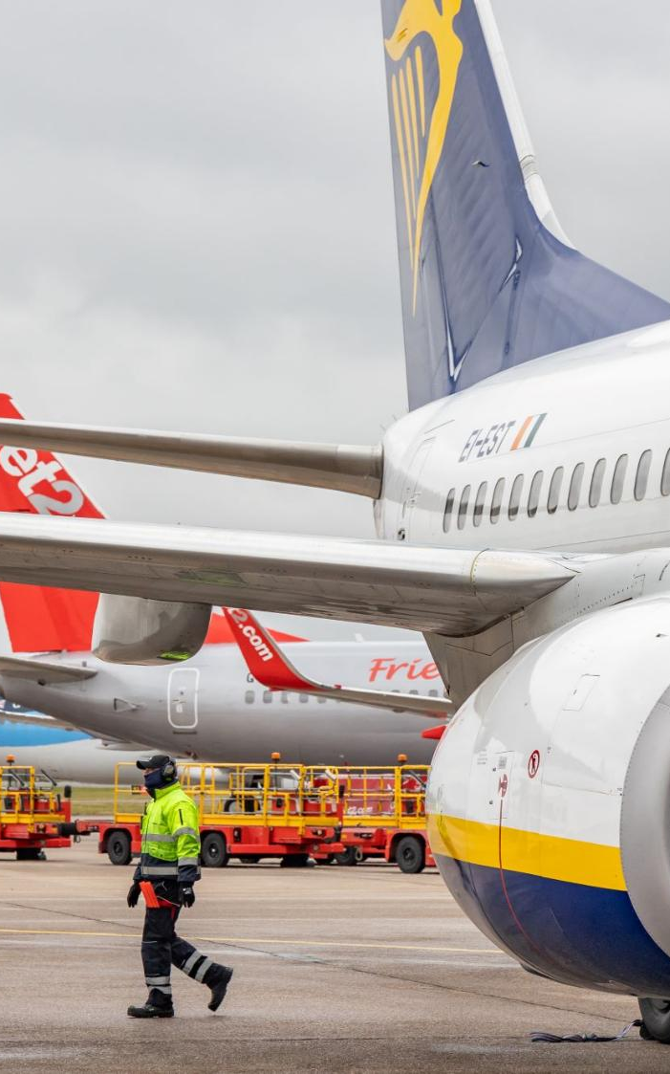
Financing

Slide 18
Capital Structure
Cash: £268m
Liquidity: £0.7bn+
(excl. £135m)
MAG’s financing strategy is to access the capital markets for medium and long-term debt to facilitate growth and investment, supported by the £500m RCF and £135m liquidity facility.
  In November 2025, MAG repriced and extended its RCF to November 2030 (with the option of two 1-year extensions to November 2032)
  In April 2026, the liquidity facility was renewed
  The RCF was undrawn throughout FY26
  MAG issued a Sterling denominated bond in January 2026, raising £300m at a coupon of 5.25%
  Liquidity in excess of £0.75bn

Slide 19
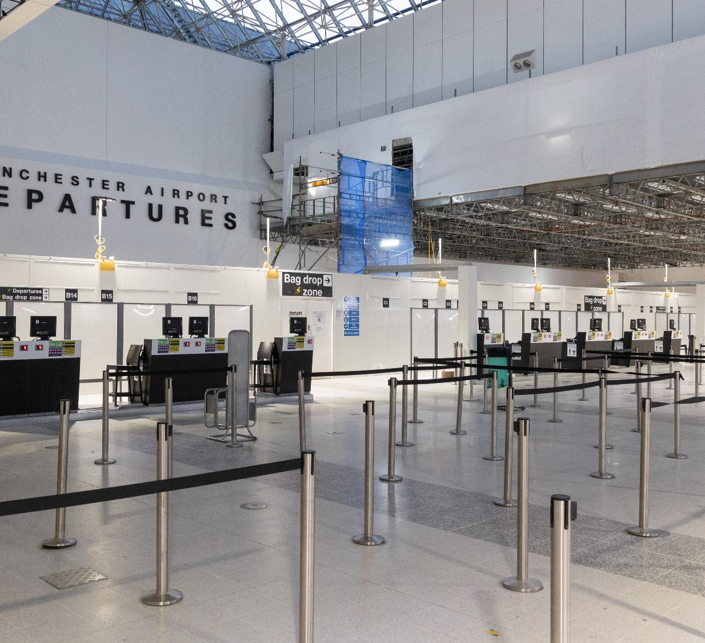
Bond Issue – January 2026
In January 2026, the Group successfully returned to the Sterling bond market, issuing a £300m long 10-year bond at a coupon of 5.25%
  MAG returned to the Sterling market following its debut Euro issuance in 2025
  MAG was the first Sterling corporate issuer of 2026, taking advantage of significant demand and liquidity in the market to achieve near record BBB+ pricing and the lowest margin ever issued by a UK airport
  Final order books were 4.8x oversubscribed with MAG achieving a margin of 80bps over gilts (5.25% coupon)
  The transaction was brought forward from a planned issuance in H1 FY27 in order to avail of favourable market conditions and de-risk MAG’s funding requirement into the next financial year
funding
  £300m
pricing
  G+80bps
FINAL BOOK
  4.8x

Slide 20
Cashflow
MAG’s operating cashflow of £609.4m was a £38.7m increase compared with last year reflecting strong trading performance. Net movement in cash for the year was an inflow of £3.8m
    Net interest paid of £256.7m, including £129.9m of interest on shareholder loans, of which £34.7m was catch-up of previously deferred interest. Additional bond interest in the year was primarily driven by first full year impact of the Euro issuance in FY25
    Corporation tax paid of £13.1m, reflecting payments on account of £50.1m, offset by a £36.8m refund for FY24 following a successful capital allowances review
    Capital spending (PPE, Intangibles and property) was £586.2m, marginally down on £628.7m in the prior year, following reduction from peak of MAN-TP, partially offset by increased spend on STN-TP and the completion of NGS (1)
    Net bond proceeds of £295.7m following issuance in January 2026
    Dividends paid relate to a C-share dividend and the CAVU joint venture at Fort Lauderdale airport. No dividends were paid in the year in respect of ordinary shares
    There were no acquisitions in the year. FY25 consideration relates to Parkos and land adjacent to Manchester Airport
£m | FY26 | FY25 | Variance
Cash generated from operations (before significant items) | 609.4 | 570.7 | 38.7
Net Interest paid | (256.7) | (209.1) | (47.6)
Tax paid | (13.1) | (61.4) | 48.3
Purchase of property, plant and equipment | (546.1) | (595.5) | 49.4
Purchase of intangible fixed assets | (36.3) | (33.2) | (3.1)
Net change in borrowings / Refinancing fees | 295.7 | 355.5 | (59.8)
Purchase of investment property | (3.8) | (13.2) | 9.4
Dividends paid to shareholders & NCI | (5.4) | (20.0) | 14.6
Adjustment for significant items | (20.8) | (25.9) | 5.1
Distribution from / (Investment in) associate | - | 0.9 | (0.9)
Consideration paid for acquisitions | - | (35.6) | 35.6
Other | (18.5) | (13.7) | (4.8)
Net movement in cash | 4.4 | (80.5) | 84.9
Cash and cash equivalents at 1 April | 264.6 | 345.1 | (80.5)
Effects of foreign exchange rate changes | (0.6) | - | (0.6)
Cash and cash equivalents at 31 March | 268.4 | 264.6 | 3.8
    (1) Cash impact only of PPE, intangible additions and property – includes the cash paid in respect of prior year accruals

Slide 21
Financial Covenants and Ratings
    MAG’s long-term financing strategy continues to incorporate strong investment grade ratings and conservative finance structure
    At 31 March 2026, leverage was 3.9x, with interest cover at 5.6x for the period
    As MAG continues to invest in its capital transformation programmes, leverage is expected to increase towards the top end of MAG’s target leverage range (3.5x-4.5x)
    Baa1/BBB+ ratings reaffirmed by Moody’s and Fitch during FY26
Leverage: net debt to ebitda
DEFAULT (7.5x)
LOCK-UP (6.0x)
INTEREST COVER: EBITDA LESS TAX/FINANCE CHARGES
Moody’s
  Baa1 (stable)
Fitch
  BBB+ (stable)
leverage
  3.9x
Interest cover
  5.6x
LOCK-UP (2.0x)
DEFAULT (1.4x)

Slide 22

Sustainability

Slide 23


Creating a sustainable future for all
FY26 marked the first full year of delivery against MAG’s refreshed Sustainability Strategy, Creating a sustainable future for all. Building on more than two decades of embedded sustainability practice, we continued to integrate environmental, social and governance priorities across our operations, while responding to an evolving regulatory and industry landscape.
Decarbonising aviation
Continued delivery of MAG’s Net Zero Transition Plan, targeting net zero airport operations by 2038.
Progressed low-carbon energy infrastructure, including the development of a 12.8MW solar farm at London Stansted.
Protecting our environment
Protecting nature
Published MAG’s Conservation Strategy, focused on how MAG protects and enhances nature across our airports.
Introduced reporting against recommendations from the Taskforce on Nature-related Financial Disclosures (TNFD), embedding nature-related risks and opportunities into our strategy, risk management and reporting.
Responsible resources
MAG signed up to the new Circularity in Practice initiative, inspired by His Majesty King Charles III.
Continued to achieve 100% diversion of waste away from landfill across the Group.
23

Slide 24


Creating a sustainable future for all
FY26 marked the first full year of delivery against MAG’s refreshed Sustainability Strategy, Creating a sustainable future for all. Building on more than two decades of embedded sustainability practice, we continued to integrate environmental, social and governance priorities across our operations, while responding to an evolving regulatory and industry landscape.
Opportunity for all
Engaged more than 19,000 people through Aerozones and Academies, supporting skills development and career pathways.
Delivered Careers Festivals across all airports, reaching 1,500+ students and connecting them with industry employers.
Meet the Buyer events, held at each airport, created opportunities for small and medium-sized enterprises to engage with and secure business within MAG’s supply chain.
Community at our core
Local voices
MAG supported over 280 local community organisations with grant funding worth more than £495,400.
94% of those at leadership level took part in volunteering activities, and MAG Colleagues logged more than 21,300 hours of volunteering.
Continued to deliver on Noise Action Plans at each airport and, this year, the proportion of latest-generation aircraft operating at MAG airports reached 29%.
24

Slide 25

Questions
Please use the raise hand function in Microsoft Teams if you wish to ask a question
www.magairports.com/investor-relations/

Slide 26

APPENDICES

Slide 27
Appendix – Reconciliation of Security Group Consolidation (MAGIL) to Group Results (MAHL)
*Adjusted EBITDA is earnings before interest, tax, depreciation, amortisation, share of result of associate, gains and losses on sales and valuations of investment properties, and before significant items
** Adjusted operating profit is before operating profit before significant items

Slide 28
Appendix – IFRS 16 Impact on MAGIL Income Statement

Slide 29
Important Notice
  The terms and conditions below set out important legal and regulatory information about the information contained in this presentation and all documents and materials in relation to this presentation (the “materials”) by Manchester Airport Group Investments Limited and its shareholders, affiliates or subsidiaries (the “MAG Group Companies”). No other third party has been involved in the preparation of, or takes responsibility for, the contents of the materials.
  The materials are confidential and are being provided to you solely for your information and may not be copied, reproduced, forwarded or published in any electronic or physical form or distributed, communicated or disclosed in whole or in part except strictly in accordance with the terms and conditions set out below, including any modifications to them from time to time. The information contained in the materials has been obtained from sources believed to be reliable but none of the MAG Group Companies guarantees its accuracy or completeness.
  EACH RECIPIENT AGREES TO BE BOUND BY THE TERMS AND CONDITIONS BELOW.
  The materials are intended for authorised use only and may not be published, reproduced, transmitted, copied or distributed to any other person or otherwise to be made publicly available. The information contained in the materials may not be disclosed or distributed to anyone. Any forwarding, redistribution or reproduction of any material in whole or in part is unauthorised. Failure to comply with this notice may result in a violation of the applicable laws of the relevant jurisdictions. Any of the MAG Group Companies has the right to suspend or withdraw any recipient’s use of the materials without prior notice at any time.
  The information contained in the materials has not been independently verified. The MAG Group Companies are under no obligation to update or keep current the information contained herein. Accordingly, no representation or warranty or undertaking, express or implied, is given by or on behalf of the MAG Group Companies or any of their respective members, directors, officers, agents or employees or any other person as to, and no reliance should be placed on, the accuracy, completeness or fairness of the information or opinions contained herein. None of the MAG Group Companies, nor any of their respective members, directors, officers or employees nor any other person accepts any liability whatsoever for any loss howsoever arising from any use of the materials or their contents or otherwise arising in connection with the materials.
  The information and opinions contained herein are provided as at the date of this presentation and are subject to change without notice.
  Where the materials have been made available in an electronic form, such materials may be altered or changed during the process of electronic transmission. Consequently none of the MAG Group Companies accepts any liability or responsibility whatsoever in respect of any difference between the materials distributed in electronic format and the hard copy versions. Each recipient consents to receiving the materials in electronic form.
  Each recipient is reminded that it has received the materials on the basis that it is a person into whose possession the materials may be lawfully delivered in accordance with the laws of the jurisdiction in which the recipient is located and the recipient may not nor is the recipient authorised to deliver the materials, electronically or otherwise, to any other person.
  The materials do not constitute or form part of and should not be construed as, an offer to sell or issue or the solicitation of an offer to buy or acquire securities of the MAG Group Companies in relation to any offering in any jurisdiction or an inducement to enter into investment activity. No part of the materials, nor the fact of its distribution, should form the basis of, or be relied on in connection with, any contract or commitment or investment decision whatsoever. Any investment decision in any offering should be made solely on the basis of the information contained in the prospectus relating to any transaction in final form prepared by the MAG Group Companies.
Neither the materials nor any copy of them may be taken or transmitted into the United States of America, its territories or possessions, or distributed, directly or indirectly, in the United States of America, its territories or possessions. Any failure to comply with this restriction may constitute a violation of U.S. securities laws. The materials are not an offer of securities for sale in the United States. The MAG Group Companies do not intend to conduct a public offering of any securities in the United States. The securities issued under any offering may not be offered or sold in the United States except pursuant to an exemption from, or transaction not subject to, the registration requirements of the Securities Act.
This presentation is made to and is directed only at, and the materials are only to be used by, persons in the United Kingdom having professional experience in matters relating to investments who fall within the definition of "investment professionals" in Article 19(5) of the Financial Services and Markets Act 2000 (Financial Promotions) Order 2005 (the "Order"), and to those persons to whom it can otherwise lawfully be distributed (such persons being referred to as "relevant persons").
In respect of any material, none of the MAG Group Companies makes any representation as to the accuracy of forecast information. These forecasts involve risk and uncertainty because they relate to events and depend on circumstances that will occur in the future. There are a number of factors that could cause actual results or developments to differ materially from those expressed or implied by these forecasts. No other persons should act on or rely on it.
The materials may include forward-looking statements. These forward-looking statements include statements concerning plans, objectives, goals, strategies, future events or performance, and underlying assumptions and other statements, which are other than statements of historical facts. The words "believe," "expect," "anticipate," "intends," "estimate," "forecast," "project," "will," "may," "should" and similar expressions identify forward-looking statements. Forward-looking statements include statements regarding: strategies, outlook and growth prospects; future plans and potential for future growth; liquidity, capital resources and capital expenditures; growth in demand for products; economic outlook and industry trends; developments of markets; the impact of regulatory initiatives; and the strength of competitors.
The materials may contain statements about future events and expectations that are forward-looking statements. Any statement in these materials that is not a statement of historical fact is a forward-looking statement that involves known and unknown risks, uncertainties and other factors which may cause the MAG Group Companies’ actual results, performance or achievements to be materially different from any future results, performance or achievements expressed or implied by such forward-looking statements. No person should rely on such statements and the MAG Group Companies do not assume any obligations to update the forward-looking statements contained herein to reflect actual results, changes in assumptions or changes in factors affecting these statements.
The forward-looking statements in the materials are based upon various assumptions, many of which are based, in turn, upon further assumptions, including, without limitation, management's examination of historical operating trends, data contained in the MAG Group Companies’ records and other data available from third parties. Although the MAG Group Companies believe that these assumptions were reasonable when made, these assumptions are inherently subject to significant uncertainties and contingencies which are difficult or impossible to predict and are beyond its control, and the MAG Group Companies may not achieve or accomplish these expectations, beliefs or projections. Neither the MAG Group Companies, nor any of their members, directors, officers, agents, employees or advisers intend or have any duty or obligation to supplement, amend, update or revise any of the forward-looking statements contained in the materials.
The information and opinions contained herein are provided as at the date of the materials and are subject to change without notice.

